Slide 1



Supply Chain Drivers and Metrics
Facility Location and Network Design
Professor Subodha Kumar

Slide 2
Supply Chain Drivers and Metrics

Slide 3
Financial Measures Of Performance
From a shareholder perspective, return on equity (ROE) is the main summary measure of a firm’s performance

Slide 4
Financial Measures Of Performance
Return on assets (ROA) measures the return earned on each dollar invested by the firm in assets

Slide 5
Financial Data for Amazon and Nordstrom

Slide 6
Financial Measures Of Performance
An important ratio that defines financial leverage is accounts payable turnover (APT)

Slide 7
Financial Measures Of Performance
ROA can be written as the product of two ratios – profit margin and asset turnover

Slide 8
Financial Measures Of Performance
Key components of asset turnover are accounts receivable turnover (ART); inventory turnover (INVT); and property, plant, and equipment turnover (PPET)

Slide 9
Financial Measures Of Performance
Measures not part of financial statements
Markdowns: discounts required to convince customers to buy excess inventory
Lost sales: represent customer sales that did not materialize because of the absence of products the customer wanted to buy

Slide 10
Design considerations for supply chain drivers

Slide 11
Facility Location and Network Design

Slide 12
The Role of Network Design
Facility role
What role, what processes?
Facility location
Where should facilities be located?
Capacity allocation
How much capacity at each facility?
Market and supply allocation
What markets? Which supply sources?

Slide 13
Competitive Factors
Positive externalities between firms
Collocation benefits all
Locating to split the market
Locate to capture largest market share

Slide 14
Framework for Network Design Decisions

Slide 15
Phase I: Distribution Network Design
Distribution Network
Service factor
Cost factor
Customer needs:
Response time
Product variety
Product availability
Customer experience
Order visibility
Returnability
Cost of meeting needs:
Inventories
Transportation
Facilities & handling
Information
Notes:
Let’s see how a distribution network should be best structured. Retailer’s perspective: Consider the context of distribution of goods from the manufacturer out to the customer. This whole slice of the SC is what we are focusing on. Our question: what is a “good” distribution network structure? How can we tell? Well …
Goal for now: Intro! Raise the issues, not: dot i’s and cross t’s! Details will follow.
The structure of the distribution network impacts both customer service and costs.
Let’s define the service related factors
Response time: time between order placement and delivery
Product variety: number of different products.
Product availability: probability of in stock upon arrival
Customer convenience: ease of placing and receiving order
Order visibility: tracking
Returnability: ease for customer to return, ability of network to handle.
Cost factors: discussed, but: facilities incl. handling, info = cost of systems incl. maint.

Slide 16
Relationship between service and number of facilities
Response Time
High
More facilities allow for a
quicker response time
Low
Number of Facilities (Total cost)
Notes:
We first consider the fundamental tradeoff: many big ones, few small ones.
Increasing the number of facilities moves them closer to the end consumer. Reduces the response time.
For example:
Seven Eleven Japan. 48% (63%) of customers within 500 (1000) meters of store. Perceived as “Large refrigerator” – frequent trips.
Distrigas slow-build strategy.
As Amazon has built warehouses, the average time from the warehouse to the end consumer has decreased.
McMaster-Carr provides 1-2 day coverage of most of the U.S from 6 facilities vs. W.W. Grainger is able to increase coverage to same day delivery using about 370 facilities (stores?).
“Information network”: caching reduces response time but increases # of virtual facilities.
Tradeoffs
Many small vs. few large facilities => econ. of scale. E.g.: convenience store vs. supermarket.
Transportation time and cost (to customer): increases for given mode if we have few facilities (distance up).
Achieving short response time despite large distance means even higher transportation cost. E.g. Laura Ashley shipping FedEx.
Amazon lowers transportation cost with increasing # of warehouses.
But facility role may not be substitutable: Starbucks, etc.

Slide 17
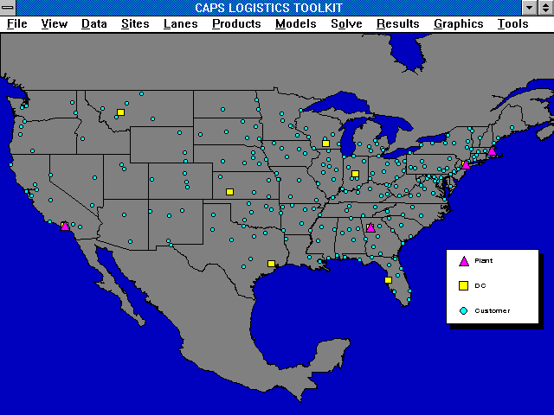
Where inventory needs to be for a 3 day order response time - typical results --> 5 DCs
Customer
DC

Slide 18
Where inventory needs to be for a next day order response time - typical results --> 13 DCs
Customer
DC

Slide 19
Where inventory needs to be for a same day / next day order response time - typical results --> 26 DCs
Customer
DC

Slide 20
Costs as a Function of Number of Facilities
Inventory
Facility costs
Costs
Transportation
Number of facilities
(Inverse of distance from customer)
Notes:
Responsiveness – Efficiency Tradeoff: How does Efficiency vary as N goes up for given output.
1. Inventory costs increase: why concave? Cycle inventory, + square root law: safety inventory for given service level (independent dem) increases as square root of N locations where held.
2. Facility costs increase: why convex?
Economies of scale in fixed (lease/construction etc.) &/or variable cost. “It costs more than half as much to set up a half as large factory.” Example: Distrigas
3. Transportation costs: why non-monotone? Let N= number of facilities
They first decrease, then increase in N:
Define: Outbound = out of facility, inbound = into facility.
Typical: Outbound unit cost>inbound unit cost since smaller lot size (exception: ore=>steel)
Cost = average cost per shipment (fct of lot size, distance) * # of shipments
Outbound cost decrease in N:
# and lot size stays constant (or increases: aggregation), distance down, so does aver. cost.
Inbound cost = average cost per shipment * # of shipments: as N increases: inbound increases.
# of shipments increases, lot size decreases => higher cost.
distance may increase/decrease: tends to go up (large N motivated by close to customer)
If lot size sufficiently small (that factor dominates), then inbound cost increase.
Example:
High Outbound: Amazon – centralization.
High inbound: Seven Eleven Japan: high inbound transportation cost due to many small stores (small lot sizes) countered by aggregating stores and products (CDC).
Note the interdependency! Facility driver impacts other costs as well!

Slide 21
Service and Cost Build-up as a Function of Facilities
Total Costs
Percent Service Level Within Promised Time
Cost of Operations
Facilities
Inventory
Transportation
Labor
Number of Facilities
(Inverse of distance from customer)
Notes:
Putting it all together: Efficiency = total cost vs. Responsiveness.
Total costs decrease and then increase as we increase the number of facilities. Distrigas: minimum level at neither extreme!
The responsiveness (here: time) improves as we increase the number of facilities.
Where should we operate?
A supply chain should always operate at least at (above) the lowest cost point.
Operating beyond that point makes sense if the revenue generated from better responsiveness exceeds the cost of better responsiveness. For example:
Building more satellite tanks in Distrigas case makes sense if for example local storage can be charged more than terminal storage. This is even true if it is under equal pricing more costly to have these tanks there than storing centrally at Everett.
Gateway opening little stores.

Slide 22
Network Design Decisions
PHASE I
Supply Chain Strategy ⇒ Broad Structure
PHASE II
Obtain Regional Facility Configuration
PHASE III
Select Suitable Sites
PHASE IV
Decide Facility Location and Capacity Allocation
Ongoing Decision: Market and supply allocation
Notes:
Phase I: Define SC strategy: What capabilities needed to support competitive strategy?
Competitive strategy = set of customer needs to be satisfied by SC.
Global competition: where will players be?
Growth strategy: acquire, build or partner for facilities?
=> How many facilities? How large? What is the role of each facility? Tailoring of SC to different business unit needs.
Phase II: Regional: Define regions for facilities and their approx. number, their potential roles (all products for one market vs. one for all markets) and approx. capacity.
Has become even more meaningful with regional trading blocks.
Demand forecast by country: magnitude and country homogeneity => econ. Of scale?
Supply: Technology: Cost, Economies of scale or scope?
Demand, exchange rate risk, political
Tariffs: rates, incentives, min. local production, import/export restrictions.
Competitors: how many, locate close/far?
Phase III: Selection of desirable sites based on hard/soft infrastructure
Phase IV: Determine Location and capacity for each facility in set of desirable sites. Goal: Max. total profits, looking at margins, demands, and SC cost.
=> we now discuss the methodologies. For location and allocation, capacity later.

Slide 23
Phase II: Regional facility configuration
Which regions should have facilities?
Key Factors:
Regional demand configuration
Taxes and tariffs
Fixed facility cost (economies of scale)
Transportation cost
Production cost
Inventory cost
Coordination cost
Notes:
Here all costs and demand are considered at the aggregate level. The region’s demand is aggregated to a suitable level (zip code, state, mid west, U.S., North America etc.) and then assumed to be located at a representative point (center of gravity?). The production, transportation and other costs are then assumed at an aggregate level. Ideally taxes and tariffs should be included and the analysis should be based on maximizing profit. This can be particularly important when taxes vary based on what is done locally.

Slide 24
Phase II: Network Optimization Models
FIGURE 5-3

Slide 25
Capacitated Plant Location Model
= number of potential plant locations/capacity
= number of markets or demand points
= 1 if plant i is open, 0 otherwise
= annual demand from market j
= quantity shipped from plant i to market j
= potential capacity of plant i
= annualized fixed cost of keeping plant i open
= cost of producing and shipping one unit from plant i to market j (cost includes production, inventory, transportation, and tariffs)
subject to

Slide 26
Capacitated Plant Location Model
FIGURE 5-4

Slide 27
Capacitated Plant Location Model
FIGURE 5-5

Slide 28
Capacitated Plant Location Model

Slide 29
Capacitated Plant Location Model
Constraints

Slide 30
Capacitated Plant Location Model
FIGURE 5-6

Slide 31
Capacitated Plant Location Model
FIGURE 5-7

Slide 32
An Example in India: Possible Impact of GST Implementation

Slide 33
A Note About GST and Its Impact
Pre GST
CST of 4% for inter-state goods transfer
VAT for within state sale (Cannot offset against input CST)
Many more (20-30 on an average) warehouses per company, one in every state
Several (20-30 on an average) C&F (Carrying and Forwarding) agents per state
Post GST
No inter-state goods transfer tax (No CST)
GST for both inter-state and within state transfers (with ability to offset)
Consolidated warehouses
Reduction in unorganized players
Replacement of multiple layers of taxes with GST which would operate at various stages of the supply chain

Slide 34
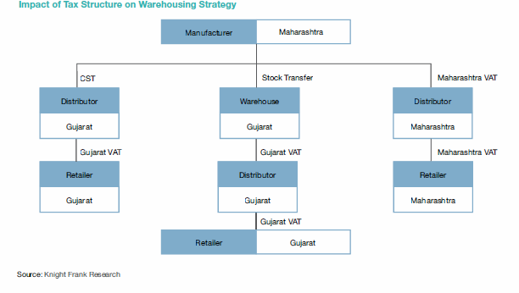
Impact of Tax Structure on Warehousing (Pre GST Regime)
Distributor prefers buying from warehouse in own state.
Source: India Logistics & Warehousing Report, Knight Frank India

Slide 35
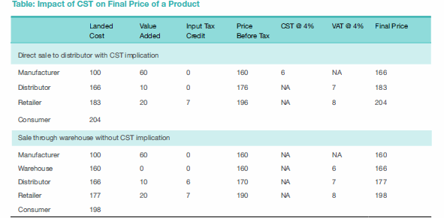
Impact of CST (Double Taxation Without Ability to Offset Input CST)
(No input tax credit)
Distributor prefers buying from warehouse in own state.
Source: India Logistics & Warehousing Report, Knight Frank India

Slide 36
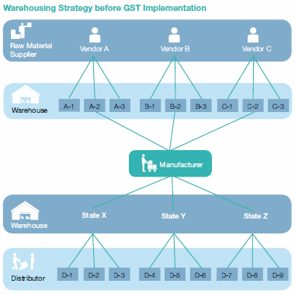
Warehousing Strategy Pre GST
Source: India Logistics & Warehousing Report, Knight Frank India

Slide 37
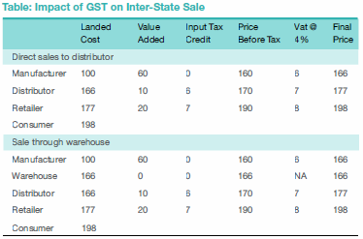
Impact of GST (Offset input GST)
Source: India Logistics & Warehousing Report, Knight Frank India

Slide 38
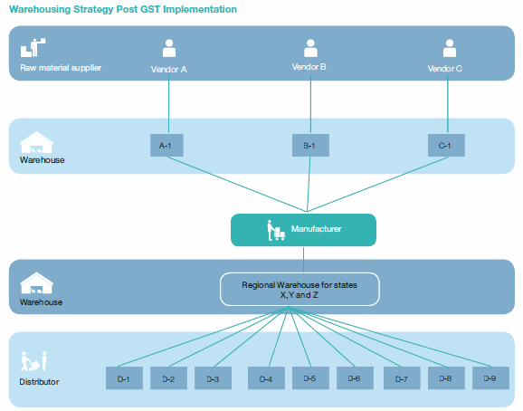
Warehousing Strategy Post GST
Source: India Logistics & Warehousing Report, Knight Frank India

Slide 39
A Note About GST and Its Impact
Warehousing Pre-GST
Most warehouses are C&F godowns with approximate size of < 10,000 sq.ft.
Extreme crunch of large scale warehousing
Poor infrastructure and basic storage facilities
Post-GST the focus will shift to centralizing
Emergence of large scale warehousing, Logistics Parks and Free Trade Warehousing Zones (FTWZs)
At least 11 to 12 FTWZs have been approved and others are in the process
For example, Arshiya
Huge growth potential exist for logistics parks (LPs)
Better infrastructure, several value added services, and better material handling technology

Slide 40
Network design decisions
PHASE I
Supply Chain Strategy ⇒ Broad Structure
PHASE II
Obtain Regional Facility Configuration
PHASE III
Select Suitable Sites
PHASE IV
Decide Facility Location and Capacity Allocation
Ongoing Decision: Market and supply allocation
Notes:
Phase I: Define SC strategy: What capabilities needed to support competitive strategy?
Competitive strategy = set of customer needs to be satisfied by SC.
Global competition: where will players be?
Growth strategy: acquire, build or partner for facilities?
=> How many facilities? How large? What is the role of each facility? Tailoring of SC to different business unit needs.
Phase II: Regional: Define regions for facilities and their approx. number, their potential roles (all products for one market vs. one for all markets) and approx. capacity.
Has become even more meaningful with regional trading blocks.
Demand forecast by country: magnitude and country homogeneity => econ. Of scale?
Supply: Technology: Cost, Economies of scale or scope?
Demand, exchange rate risk, political
Tariffs: rates, incentives, min. local production, import/export restrictions.
Competitors: how many, locate close/far?
Phase III: Selection of desirable sites based on hard/soft infrastructure
Phase IV: Determine Location and capacity for each facility in set of desirable sites. Goal: Max. total profits, looking at margins, demands, and SC cost.
=> we now discuss the methodologies. For location and allocation, capacity later.

Slide 41
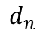
Phase III: Gravity Location Models
x_{n}, y_{n}: coordinate location of either a market or supply source n
F_{n}: cost of shipping one unit for one mile between the facility and either market or supply source n
D_{n}: quantity to be shipped between facility and market or supply source n
Warehouse
(x,y)
(x_{n} y_{n})
(x, y) is the location selected for the facility, the distance d_{n} between the facility at location (x, y) and the supply source or market n is given by

Slide 42
Gravity Location Model
Sources/Markets | Transportation Cost $/Ton Mile (F_{n}) | Quantity in Tons (D_{n}) | Coordinates
 |  |  | x_{n} | y_{n}
Supply sources
Buffalo | 0.90 | 500 | 700 | 1,200
Memphis | 0.95 | 300 | 250 | 600
St. Louis | 0.85 | 700 | 225 | 825
Markets
Atlanta | 1.50 | 225 | 600 | 500
Boston | 1.50 | 150 | 1,050 | 1,200
Jacksonville | 1.50 | 250 | 800 | 300
Philadelphia | 1.50 | 175 | 925 | 975
New York | 1.50 | 300 | 1,000 | 1,080
Total transportation cost

Slide 43
Gravity Location Model

Slide 44
Gravity Location Model

Slide 45
Gravity Location Model
For each supply source or market n, evaluate d_{n}
Obtain a new location (x’, y’) for the facility, where
If the new location (x’ , y’ ) is almost the same as (x, y) stop. Otherwise, set (x, y) = (x’ , y’ ) and go to step 1

Slide 46
Network Design Decisions
PHASE I
Supply Chain Strategy ⇒ Broad Structure
PHASE II
Obtain Regional Facility Configuration
PHASE III
Select Suitable Sites
PHASE IV
Decide Facility Location and Capacity Allocation
Ongoing Decision: Market and supply allocation
Notes:
Phase I: Define SC strategy: What capabilities needed to support competitive strategy?
Competitive strategy = set of customer needs to be satisfied by SC.
Global competition: where will players be?
Growth strategy: acquire, build or partner for facilities?
=> How many facilities? How large? What is the role of each facility? Tailoring of SC to different business unit needs.
Phase II: Regional: Define regions for facilities and their approx. number, their potential roles (all products for one market vs. one for all markets) and approx. capacity.
Has become even more meaningful with regional trading blocks.
Demand forecast by country: magnitude and country homogeneity => econ. Of scale?
Supply: Technology: Cost, Economies of scale or scope?
Demand, exchange rate risk, political
Tariffs: rates, incentives, min. local production, import/export restrictions.
Competitors: how many, locate close/far?
Phase III: Selection of desirable sites based on hard/soft infrastructure
Phase IV: Determine Location and capacity for each facility in set of desirable sites. Goal: Max. total profits, looking at margins, demands, and SC cost.
=> we now discuss the methodologies. For location and allocation, capacity later.

Slide 47
Phase IV: Facility location, capacity and demand allocation
Typical problem when rationalizing supply chain network
Which plants to keep open?
What capacity to assign to each plant?
Which markets to assign to each plant?
Notes:
Precise location.

Slide 48
Phase IV: Network Optimization Models
Supply City | Demand City Production and Transportation Cost per Thousand Units (Thousand $) |  |  |  |  |  | Monthly Capacity (Thousand Units) K | Monthly Fixed Cost (Thousand $) f
 | Atlanta | Boston | Chicago | Denver | Omaha | Portland
Baltimore | 1,675 | 400 | 985 | 1,630 | 1,160 | 2,800 | 18 | 7,650
Cheyenne | 1,460 | 1,940 | 970 | 100 | 495 | 1,200 | 24 | 3,500
Salt Lake City | 1,925 | 2,400 | 1,450 | 500 | 950 | 800 | 27 | 5,000
Memphis | 380 | 1,355 | 543 | 1,045 | 665 | 2,321 | 22 | 4,100
Wichita | 922 | 1,646 | 700 | 508 | 311 | 1,797 | 31 | 2,200
Monthly demand (thousand units) D_{j} | 10 | 8 | 14 | 6 | 7 | 11
TABLE 5-2

Slide 49
Network Optimization Models
Allocating demand to production facilities
= number of factory locations
= number of markets or demand points
x_{ij} = quantity shipped from factory i to market j
= annual demand from market j
= capacity of factory i
= cost of producing and shipping one unit from factory i to market j
subject to

Slide 50
Network Optimization Models
Optimal demand allocation
 |  | Atlanta | Boston | Chicago | Denver | Omaha | Portland
TelecomOne | Baltimore | 0 | 8 | 2
 | Memphis | 10 | 0 | 12
 | Wichita | 0 | 0 | 0
HighOptic | Salt Lake |  |  |  | 0 | 0 | 11
 | Cheyenne |  |  |  | 6 | 7 | 0
TABLE 5-3

Slide 51
Capacitated Plant Location Model
Merge the companies
Solve using location-specific costs
y_{i} = 1 if factory i is open, 0 otherwise
x_{ij} = quantity shipped from factory i to market j

Slide 52
Capacitated Plant Location Model
FIGURE 5-9

Slide 53
Capacitated Plant Location Model

Slide 54
Capacitated Plant Location Model

Slide 55
Capacitated Plant Location Model

Slide 56
Capacitated Plant Location Model

Slide 57
Capacitated Model With Single Sourcing
Market supplied by only one factory
Modify decision variables
y_{i} = 1 if factory i is open, 0 otherwise
x_{ij} = 1 if market j is supplied by factory i, 0 otherwise
subject to

Slide 58
Capacitated Model With Single Sourcing
Optimal network configuration with single sourcing
 | Open/ Closed | Atlanta | Boston | Chicago | Denver | Omaha | Portland
Baltimore | Closed | 0 | 0 | 0 | 0 | 0 | 0
Cheyenne | Closed | 0 | 0 | 0 | 0 | 0 | 0
Salt Lake | Open | 0 | 0 | 0 | 6 | 0 | 11
Memphis | Open | 10 | 8 | 0 | 0 | 0 | 0
Wichita | Open | 0 | 0 | 14 | 0 | 7 | 0
TABLE 5-4

Slide 59
Locating Plants and Warehouses Simultaneously
FIGURE 5-13

Slide 60
Locating Plants and Warehouses Simultaneously
Model inputs
m = number of markets or demand points
n = number of potential factory locations
l = number of suppliers
t = number of potential warehouse locations
D_{j} = annual demand from customer j
K_{i} = potential capacity of factory at site i
S_{h} = supply capacity at supplier h
W_{e} = potential warehouse capacity at site e
F_{i} = fixed cost of locating a plant at site i
f_{e} = fixed cost of locating a warehouse at site e
c_{hi} = cost of shipping one unit from supply source h to factory i
c_{ie} = cost of producing and shipping one unit from factory i to warehouse e
c_{ej} = cost of shipping one unit from warehouse e to customer j

Slide 61
Locating Plants and Warehouses Simultaneously
Goal is to identify plant and warehouse locations and quantities shipped that minimize the total fixed and variable costs
y_{i} = 1 if factory is located at site i, 0 otherwise
y_{e} = 1 if warehouse is located at site e, 0 otherwise
x_{ej} = quantity shipped from warehouse e to market j
x_{ie} = quantity shipped from factory at site i to warehouse e
x_{hi} = quantity shipped from supplier h to factory at site i

Slide 62
Locating Plants and Warehouses Simultaneously
subject to

Slide 63
Accounting for Taxes, Tariffs, and Customer Requirements
A supply chain network should maximize profits after tariffs and taxes while meeting customer service requirements
Modified objective and constraint

Slide 64
Summary of Learning Objectives
Understand the role of network design in a supply chain
Identify factors influencing supply chain network design decisions
Develop a framework for making network design decisions
Use optimization for facility location and capacity allocation decisions
Notes:
Notes:

Slide 65
Session 3: What’s Next
Managing transportation in supply chain
Suggested Reading: Chapter 14 (Chopra and Meindl)

